Slide 1
Computers
Sue Kayton
April 2011

Slide 2
The Basics
Keep the computer physically clean
Don’t install programs you don’t need
Watch out for viruses!
Turn off the computer when not in use
Back up important data

Slide 3
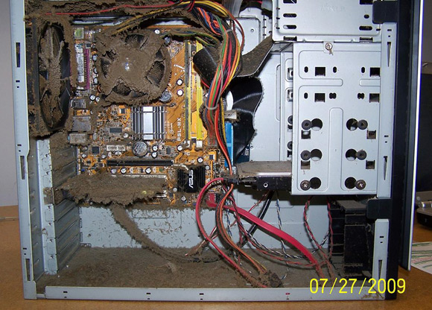

Slide 4
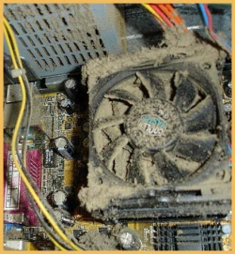

Slide 5
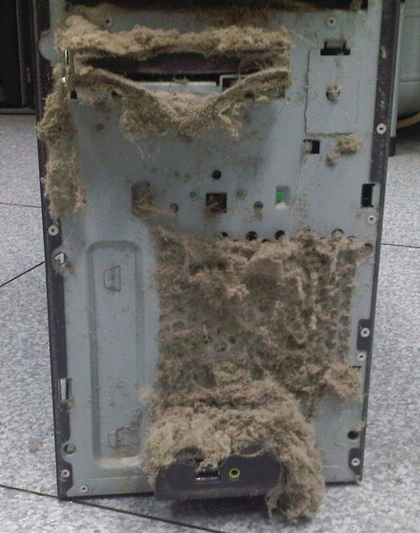

Slide 6
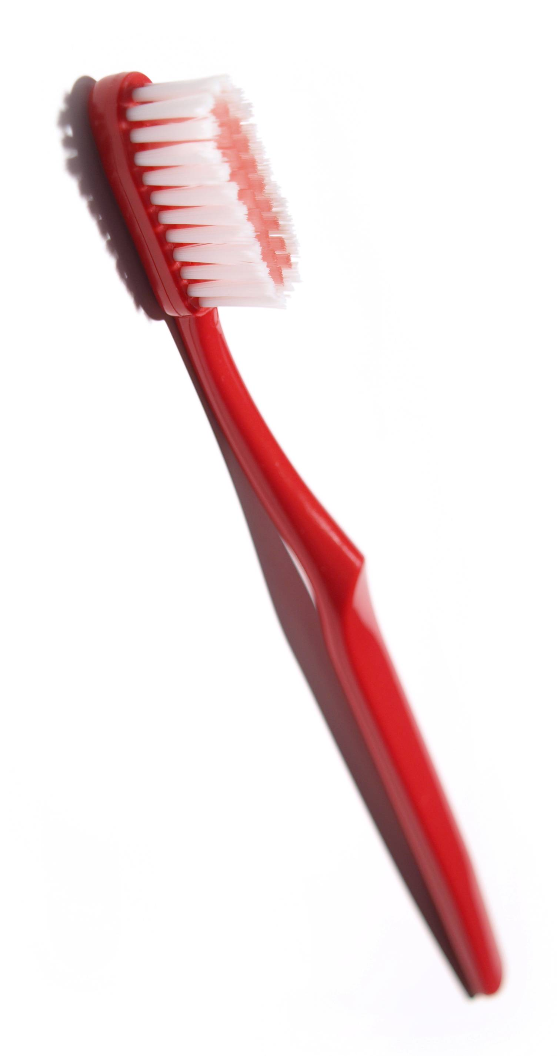
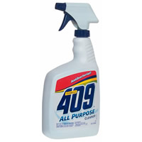
Clean your computer twice a year

Slide 7
Don’t abuse your laptop!

Slide 8
Be nice to your laptop
Turn off when not being used.
Prop up so air can circulate underneath
Don’t use on soft surface if it has bottom vent holes
Keep food and drink away
Remove CDs and DVDs from drive when not in use

Slide 9
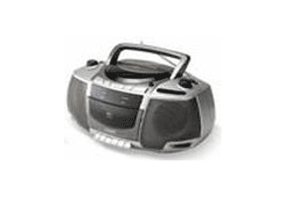
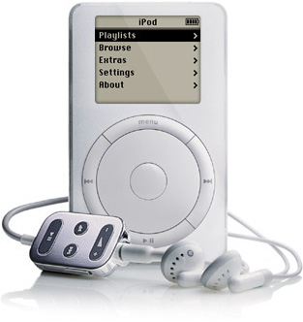
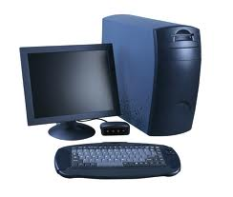
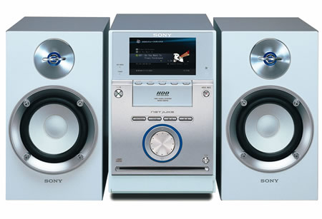
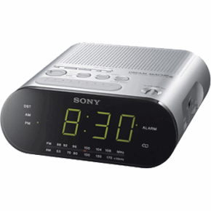
What do you use for music?

Slide 10
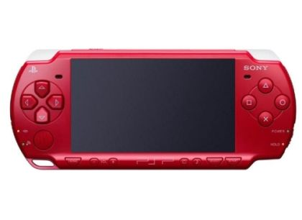
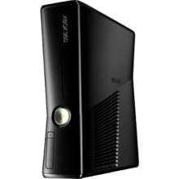
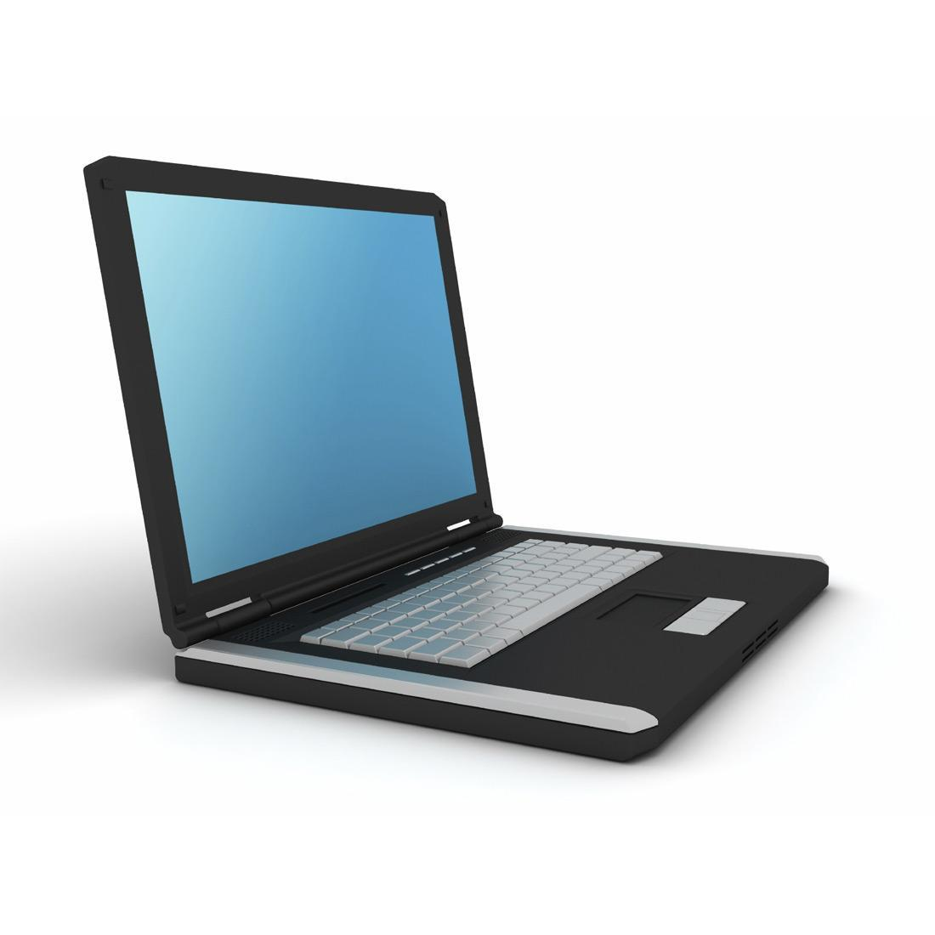
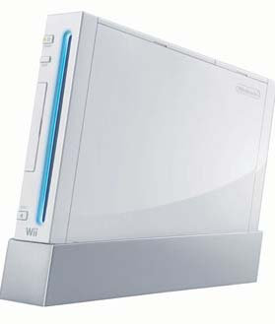
What do you use for games?

Slide 11
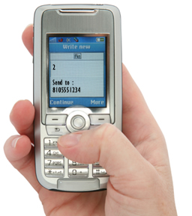
What do you use to chat?

Slide 12
Typing
http://www.youtube.com/watch?v=80cm0lyeqCI

Slide 13
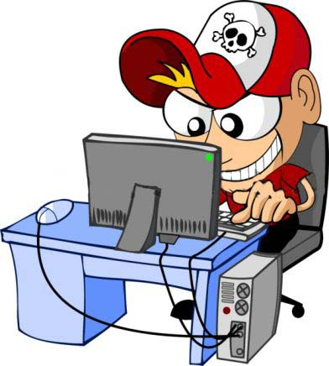
Criminals

Slide 14
How to avoid viruses
Don’t download free music
Don’t download free pornography
Don’t visit questionable websites
Don’t open iffy attachments
Paid music (iTunes) is OK

Slide 15
Real anti-virus programs
Recommended
Norton Anti-Virus, (free download for Comcast customers) http://security.comcast.net
McAfee Virus Scan
Kaspersky Anti-Virus
Symantec Anti-Virus, Symantec Endpoint Protection, or Symantec Client Security
Not recommended
Suites or full protection packages, AVG, Panda, Trend, Avira, Microsoft, Avast

Slide 16
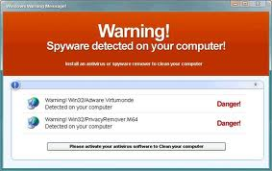
Fake anti-virus programs
Be paranoid!
Don’t be fooled by fake alerts
Don’t visit questionable websites

Slide 17
Useful free software
Picasa free photo editor and organizer
Google Earth
Agent Ransack – search for lost files
Adobe Reader – read government forms
GFI Backup – incremental data backup
K-9 Bluecoat – parental control of internet

Slide 18
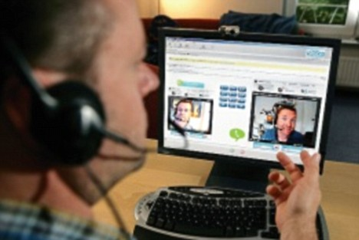
Free phone calls anywhere

Slide 19
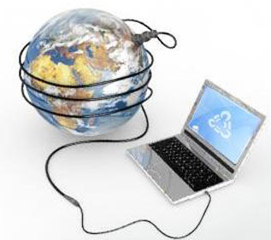
Internet
One paid connection is good for up to 10 computers
You can share your neighbor’s connection

Slide 20
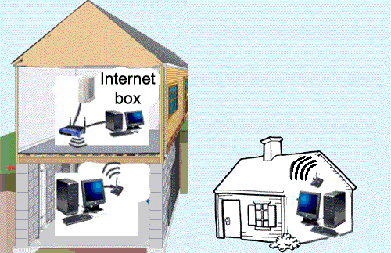
Sharing internet with a neighbor

Slide 21
What computer is best for me?

Slide 22
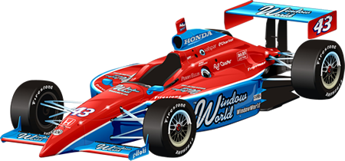
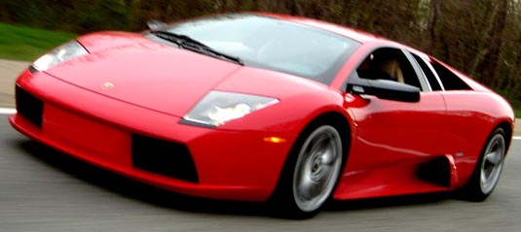
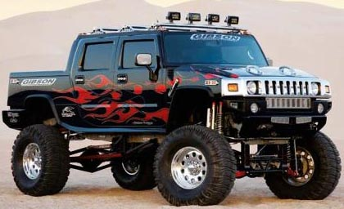
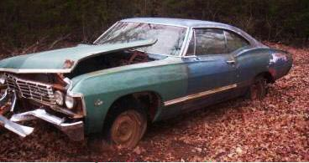
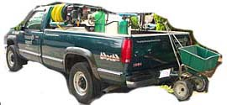
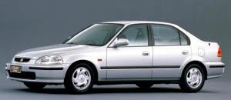
What car is best for me?

Slide 23
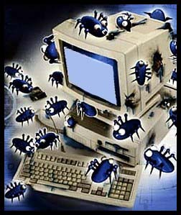
Buy a used computer?

Slide 24
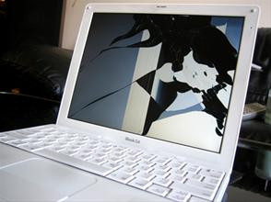

Slide 25
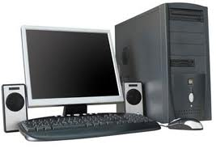
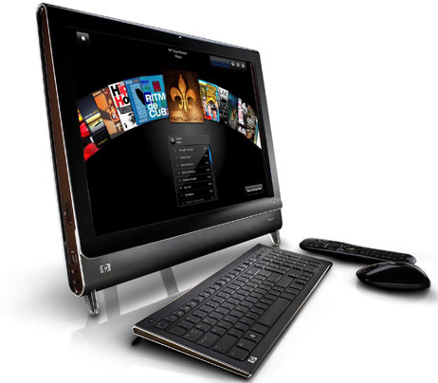

Slide 26
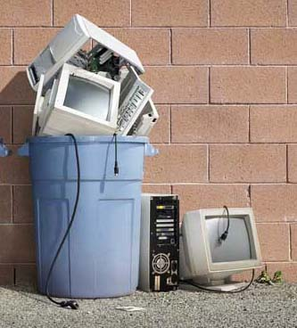
Buying on installments
2011
2012
2013

Slide 27
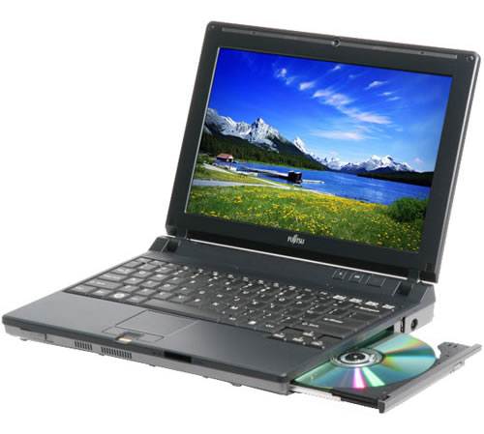
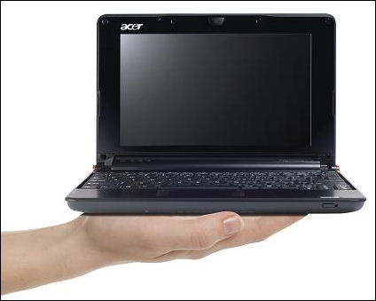
Many kinds of computers
Desktop
Laptop (also called notebook)
Netbook
Convertible laptop / tablet
Tablet
Smart Phone

Slide 28
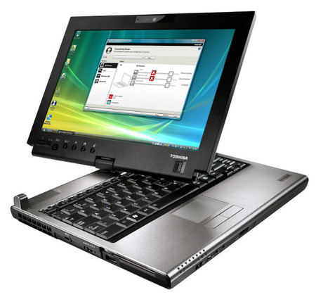
Convertible laptop / tablet

Slide 29
Computer prices

Slide 30
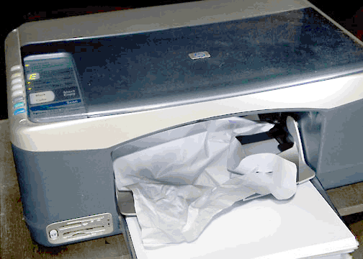
Printers

Slide 31
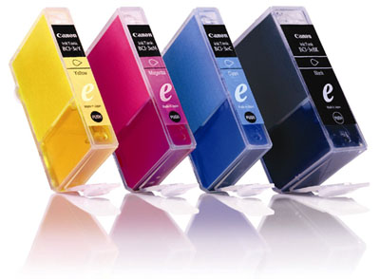
Printers
You can print free at school
Printers are cheap, but ink is very expensive
$80

Slide 32
BACK UP !!

Slide 33
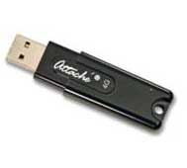
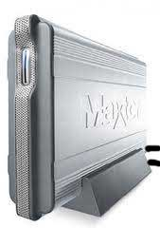
Backup
Data backup
USB keychain drive
Online backup
External hard drive
GFI Backup software
System backup
Windows backup
Acronis software
Cloud backup
Dropbox

Slide 34
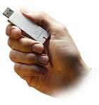
USB flash drives
Back up your important files
Carry your files to school to print
Share files with a friend
$10

Slide 35
Computer too slow?
Virus
Hard drive too full
Downloading updates
Too many startup items
Delete temp files
Overheating due to dirt
Not enough memory

Slide 36
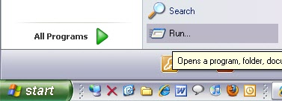
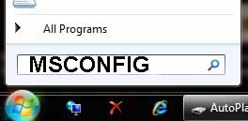
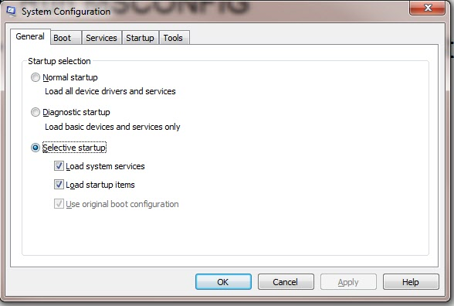
MSCONFIG to change startup

Slide 37
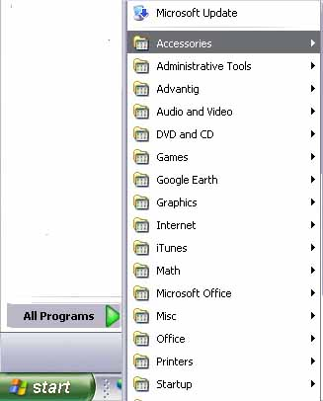
Delete items from Startup folder

Slide 38
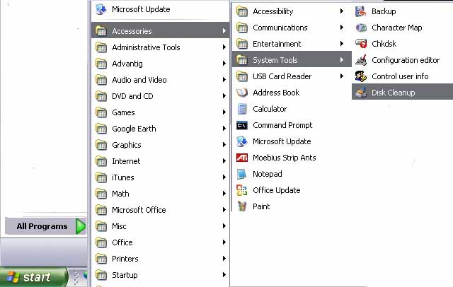
Delete temp files
Run Disk Cleanup

Slide 39
Computer careers
Technician
Programmer
Website design
Networking and security
Sales
Customer service and phone support
Engineer

