Slide 1
Introduction to Computers

Slide 2
Do I need an expensive new computer?
No

Slide 3
What computer is best for me?

Slide 4
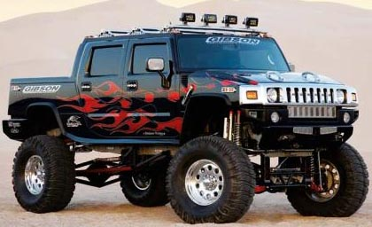
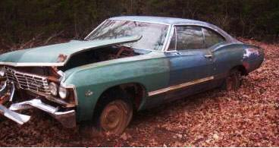
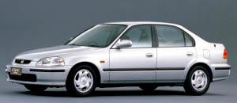
Which car is best ?

Slide 5
COMPUTER
Desktop
Laptop (notebook)
They run programs
INFORMATION APPLIANCE
Tablet
Kindle or Nook
Smart phone
Smart TV
Use apps

Slide 6
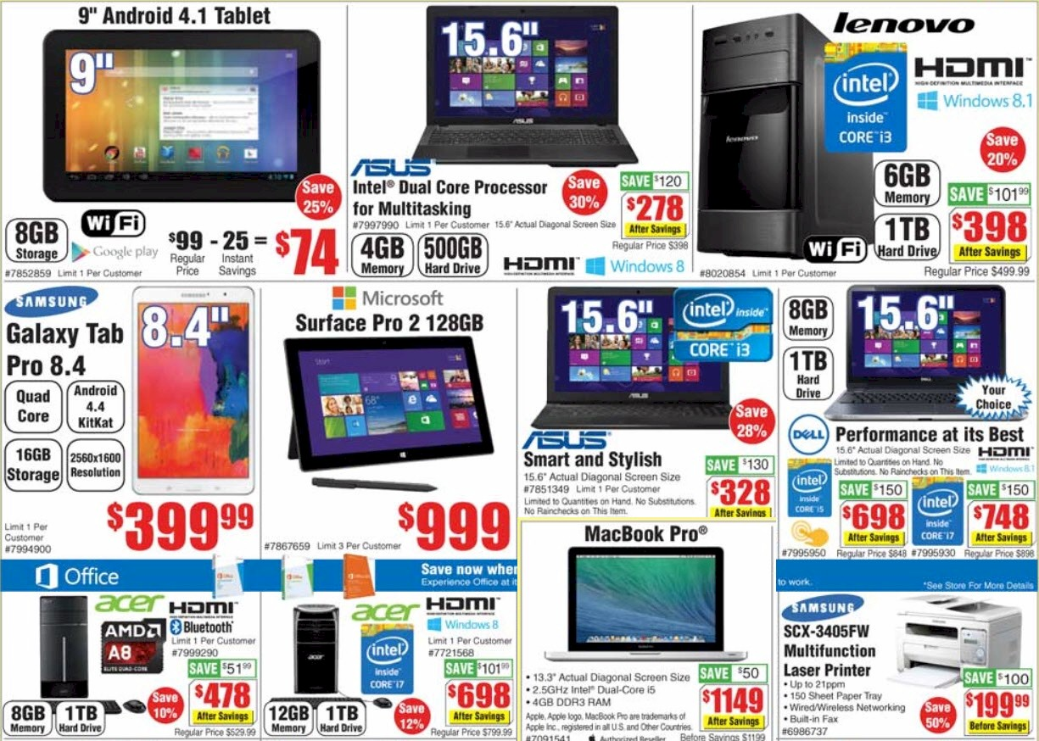

Slide 7
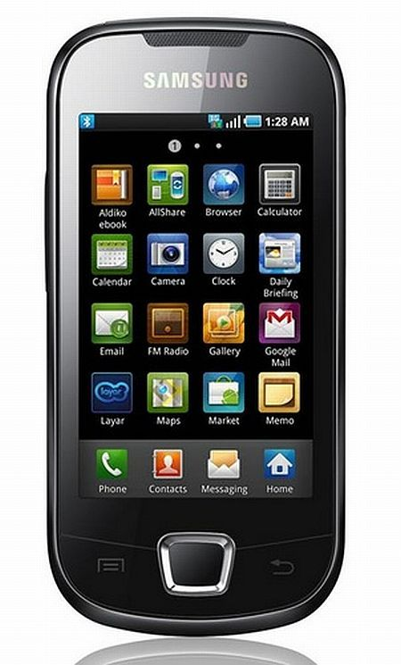
Smart phone
Calls
Texts
Email
Find information
Camera
Apps
Maps / GPS
Games

Slide 8
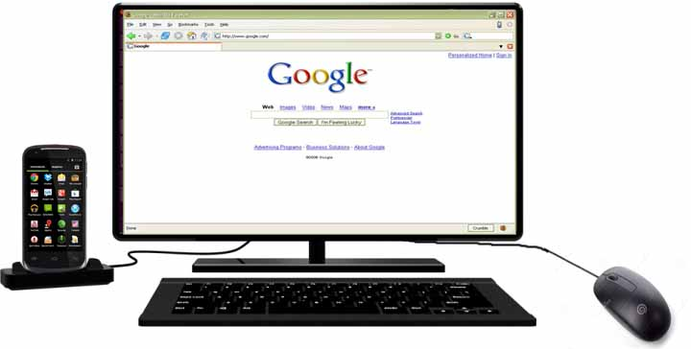
Use the phone with a dock

Slide 9
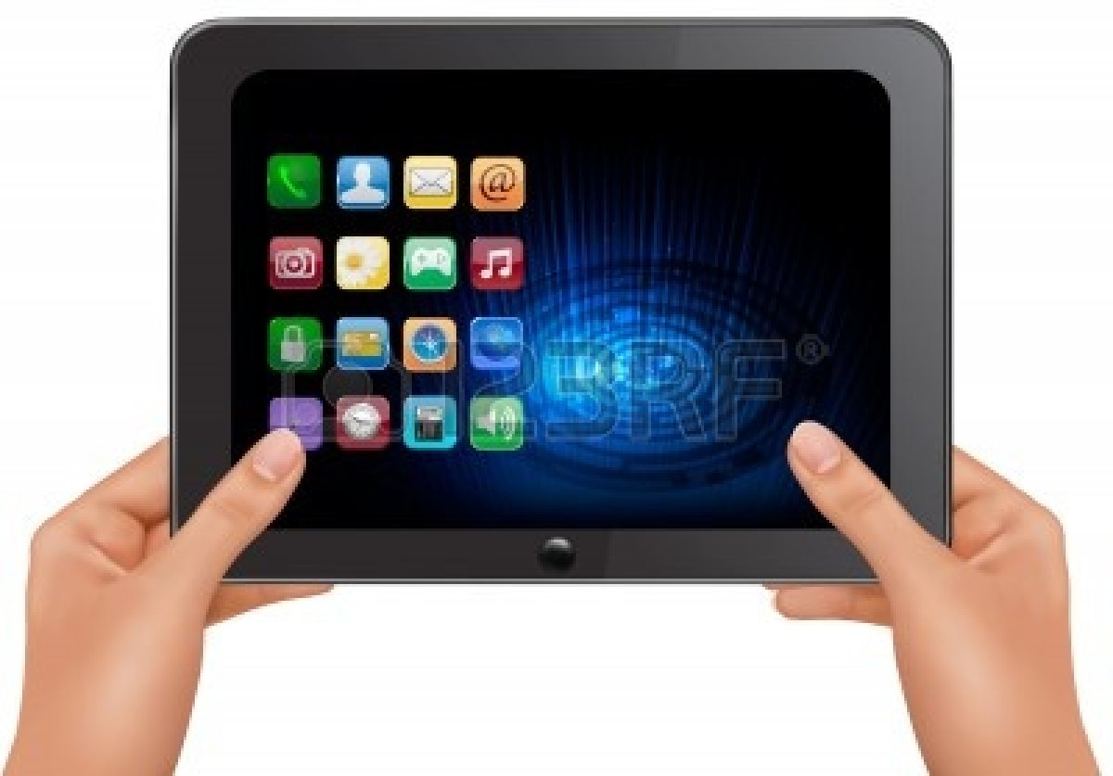
Tablet
Watch movies and TV
Listen to music
Email
Type documents
Find information
Look at photos
Read books
Camera
Many apps

Slide 10
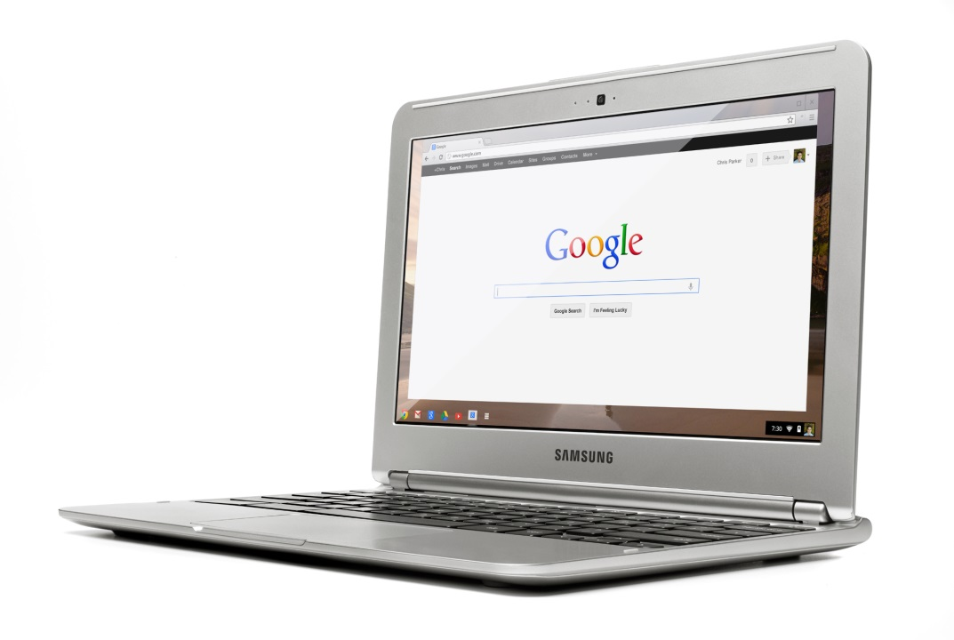
Chromebook
Stripped-down computer
Like a smart phone with a big screen
Has a keyboard
Uses Chrome, Google Drive, Google Docs
Sync with Dropbox
Use smart phone apps

Slide 11
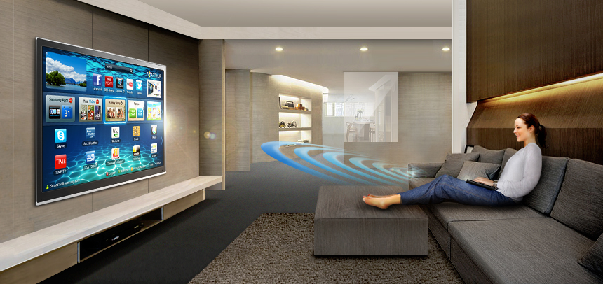

Slide 12
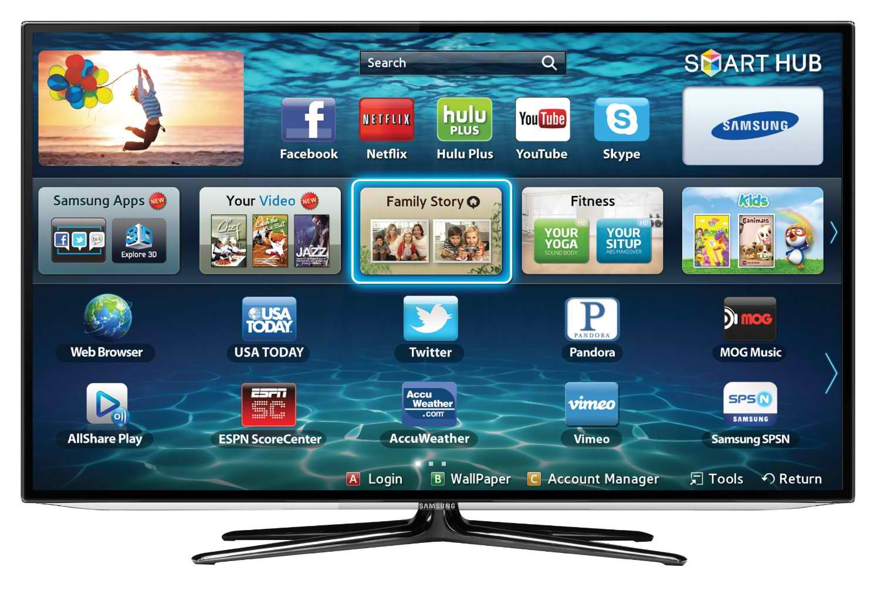
Smart TV
Find information
Download movies
Use the internet
Use apps
Type documents
TV and computer

Slide 13
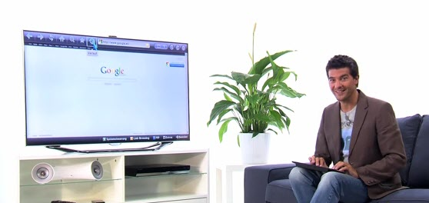

Slide 14
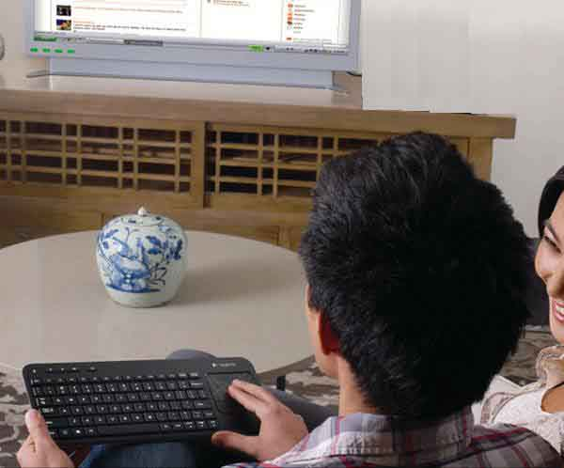

Slide 15
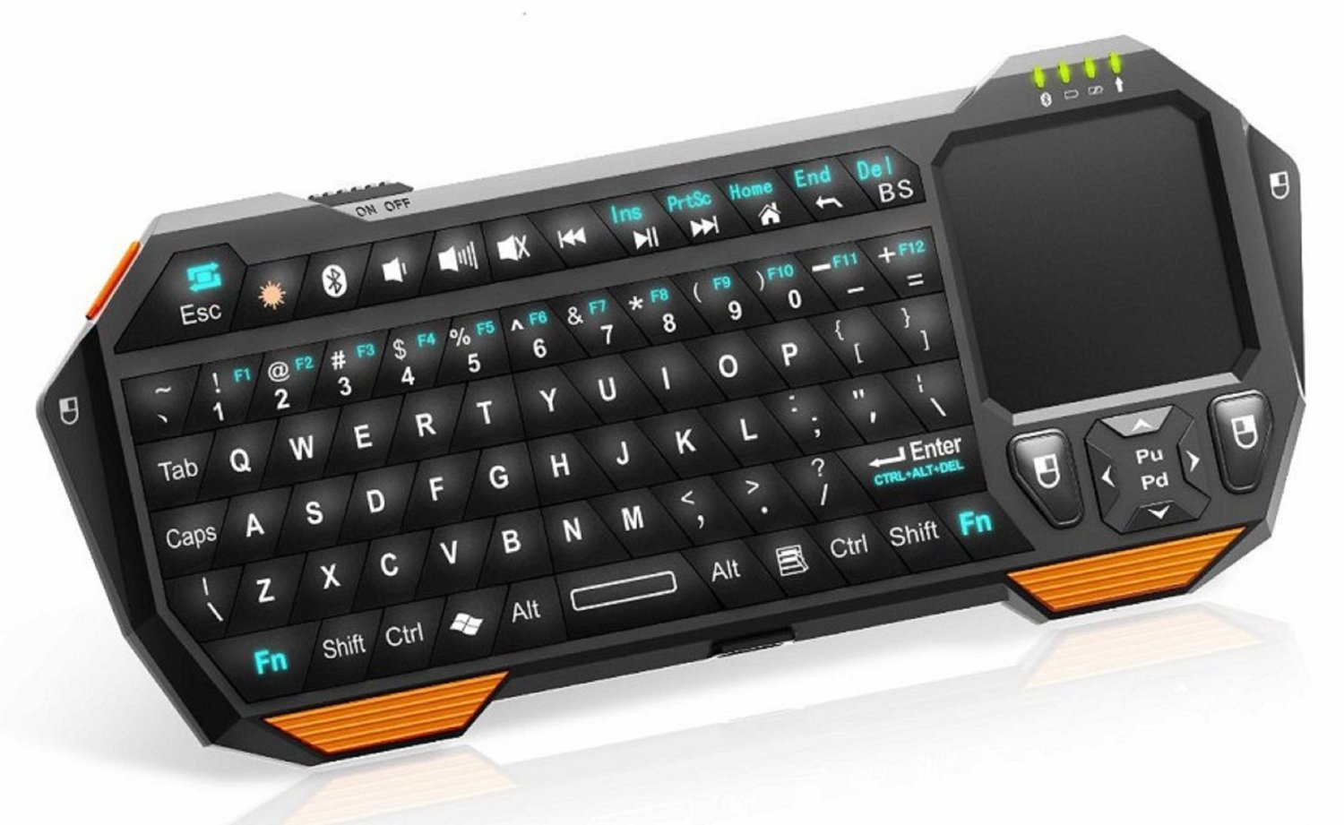
Bluetooth keyboard

Slide 18
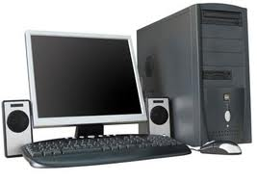
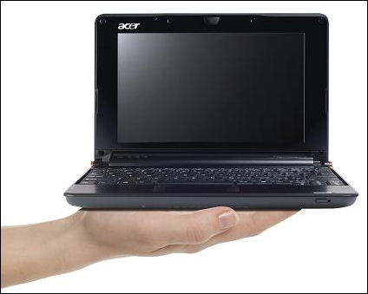
Types of computers
SmartPhone $50 - $500
Android tablet $80 - $300
ChromeBook $150 - $300
Notebook or laptop $250 - $500
Desktop $300 - $700

Slide 19
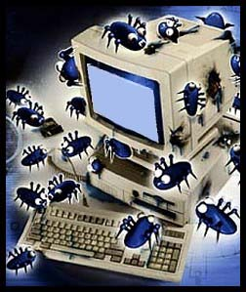
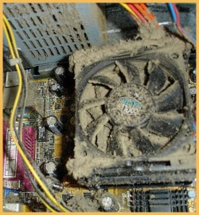
Used computers

Slide 20
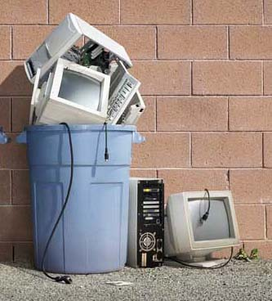
Buying on installments
2014
2015
2016

Slide 21
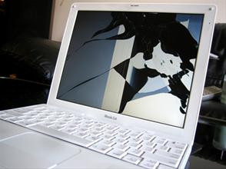

Slide 22
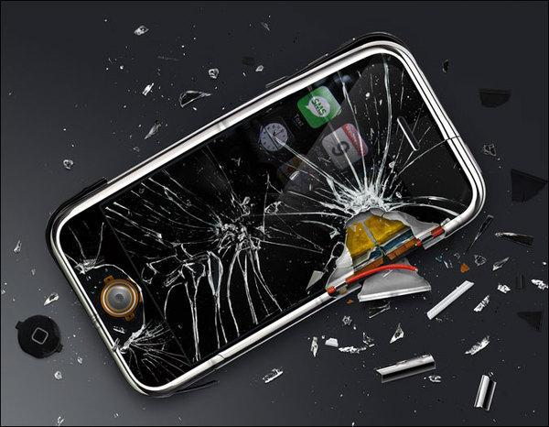

Slide 23
If you have room and money, get a desktop computer

Slide 24
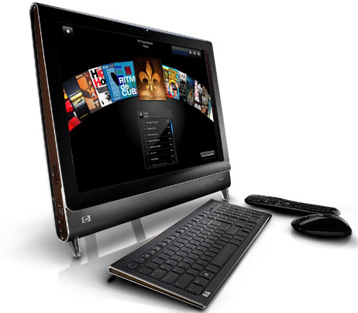
Easy to fix
Inexpensive
Last for 5 - 9 years
Repairs very expensive
Expensive to buy
Take u[ less space
Last for 3 - 4 years

Slide 25
Basic internet for $10 a month Call 1-855-846-8376

Slide 26
$65 monthly
After the first year
(very fast)
$25 monthly
After the first year
(slower)

Slide 27
Internet
One paid connection is good for 10 computers
You can connect to the neighbors for free with permission

Slide 28
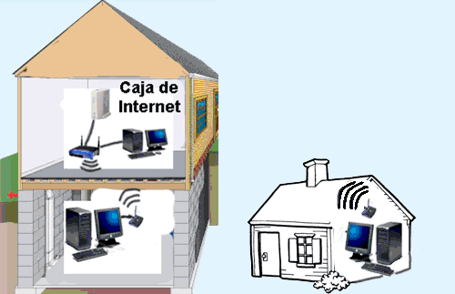
Sharing internet with neighbors

Slide 29
Controlling access to the Internet
Block evil websites
Control hours when Internet is used
The program K9 Bluecoat is free and easy to use. (www.k9webprotection.com)

Slide 30
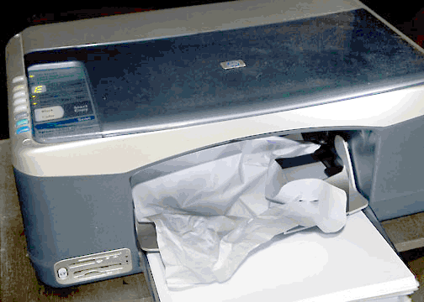
Printers

Slide 31
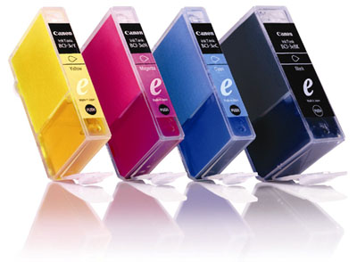
Printers
Print free at Little House or the library
Printers are cheap, but ink is expensive
$80

Slide 32
Saving files
Save your important files
Take files to Little House to print
Share files with friends or family
$10

Slide 33
Typing
http://www.youtube.com/watch?v=80cm0lyeqCI

Slide 34
How to not catch viruses
Never download free music. (LimeWire, iMesh, BearShare, Ares)
Never download pornography
Be careful on the Internet
Be suspicious of emails

Slide 35
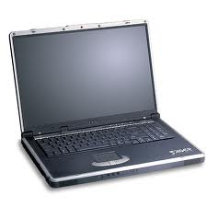
Windows computers
$300 - $1000
Last for 7 – 8 years
$250 - $700
Last for 2 – 4 years

Slide 36
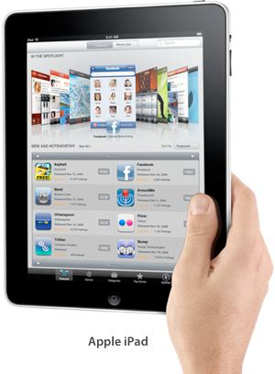
Tablets and notebooks
iPad
$400 - $800
Last 1 - 2 years
Windows
$250 - $400
Last 1 - 2 years

Slide 37
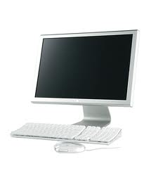
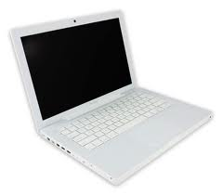
Mac (Apple) computers
$800-$2000
Last 3 – 4 years
$800-$3000
Last 2 – 4 years

