Slide 1
2020
Feb 28
Contemporary
Chile

Slide 4
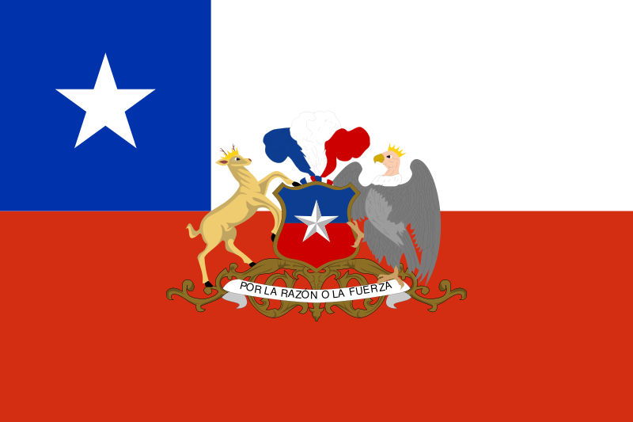

Slide 6
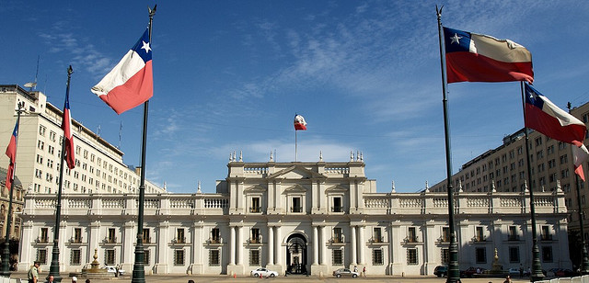

Slide 8
cia.gov Square kilometers
Canada 9,984,670
US 9,629,091
Peru 1,285,216
Bolivia 1,098,581
Chile 756,102

Slide 9
Area comparison
• Chile 100%
Texas 92%
Montana 50%
Missouri 24%

Slide 10
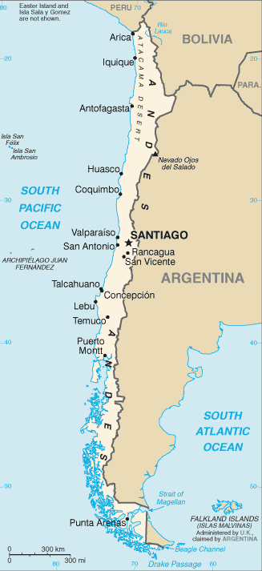
Geography
Surface area: 756,102 sq.kms
291,932 sq.miles
4,300 kms - 2,700 miles from the border with Peru to Cape Horn
Most of Chile´s population (17 million) lives in the Central Valley
Longest north-south trending country in the world,
Extending across 38 degrees of latitude

Slide 11
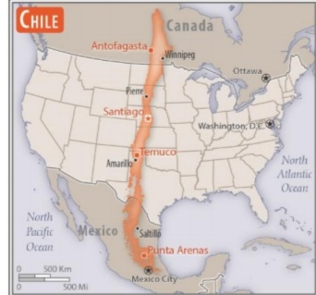

Slide 12
Main Geographical Regions
The country is conventionally divided in four main geographical regions
Norte Grande and Norte Chico
Valle Central (Mediterranean)
Sur (Temperate)
Zona Austral (Temperate)
Otherwise there are 16 administrative regions, sometimes named, sometimes numbered (I-XVI)

Slide 13
Lat 19-56 S . Lon. 70 W

Slide 14
NORTE GRANDE 8 degrees: 19° S - 27° S

Slide 15
EASTER ISLAND 63,2 sq mi 1,950 N Miles from Chilean coast 27° S 109°W

Slide 16
NORTE CHICO 5 degrees 27°S – 32°S

Slide 17
ZONA CENTRAL 4 degrees 32°S – 36S

Slide 18
ZONA SUR 5 degrees 36°S – 41°S

Slide 19
ZONA AUSTRAL 15 degrees 41°S – 56°S

Slide 20
Irrigated land
11,100 sq Kms
1.47%
0f total
756,102 sq Kms

Slide 21
CONTEMPORARY CHILE
XIII -Military regime 1973-1990
-Dictatorship
-Tiranny
XIV -Democracy restored 1990
XV -Global Protests 2019.

Slide 22
IX War of the Pacific 1879-1883
Cause:
Nitrate exploitation in Bolivian territory
Chilean capitals and workers at risk because of dispute about taxes.

Slide 23
Consequence: Expansion to the North
PERU
65,413 Square Kilometers
BOLIVIA
120,000 Square Kilometers

Slide 24
185,413
Square Kilometers
-An increment of 32%
-A quarter of actual area

Slide 25
Copper mines are located in the territory that belonged to Bolivia and Peru
Of Total World Copper Production
Chile 34%
Peru 8%

Slide 26
1884
-Chile pays the overdue debt that Peru had with UK investors of Nitrate exploitation.
-Chile invites UK inverstors to invest in Nitrate exploitation.

Slide 27
Augusto Pinochet Salvador Allende

Slide 28
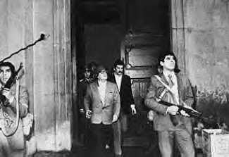
Sept 11, 1973

Slide 29
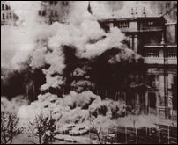

Slide 30
Salvador Allende Gossens 1970 - 1973

Slide 31
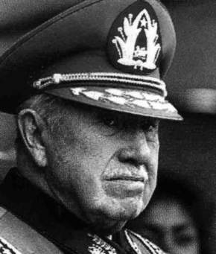
XIII MILITARY REGIME – DICTATORSHIP –TYRANNY Sep 11, 1973 - Mar 11, 1990

Slide 32
HIGH TOLL
Human rights violations.
Torture
Nearly three thousand victims of dissapearances and arbitrary executions.

Slide 33
Many Chileans in exile
Strong conflict between the Military and Catholic Church
Elimination of Political Parties

Slide 34
Press censorship
Congress recession
Profound division among Chileans

Slide 35
Aftermath
1980 Constitution
Social security reform
Free market economic system

Slide 36
1988
Pinochet calls for a Referendum

Slide 37
YES
Augusto Pinochet
President
with elected Congress
Term
1990 – 1998

Slide 38
NO
Elections in 1989

Slide 39
RESULT
YES
44.01%
NO
55.99%

Slide 40
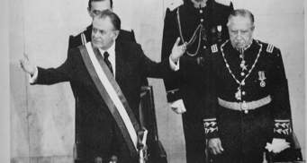
XIV Democracy restored 1990

Slide 41
Ancud Schooner

Slide 42
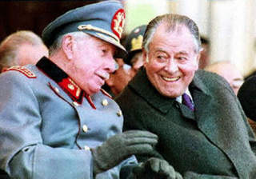
President Patricio Aylwin converses with Commander in Chief of the Army, General Military Parade September 1990Augusto Pinochet

Slide 43
SEVEN PRESIDENTIAL TERMS 1990 - 2022
Years
1.Patricio Aylwin 1990 - 1994 4
2.Eduardo Frei 1994 - 2000 6
3.Ricardo Lagos 2000 - 2006 6
4.Michelle Bachelet 2006 - 2010 4
5.Sebastián Piñera 2010 - 2014 4
6.Michelle Bachelet 2014 - 2018 4
7.Sebastián Piñera 2018 - 2022 4

Slide 44
Michelle Bachelet Jeria 2006 – 2010/2014 - 2018

Slide 45
XV Global Protests Oct 18, 2019 - ??? ??,????

Slide 46
Baquedano Square Dignity Square

Slide 47
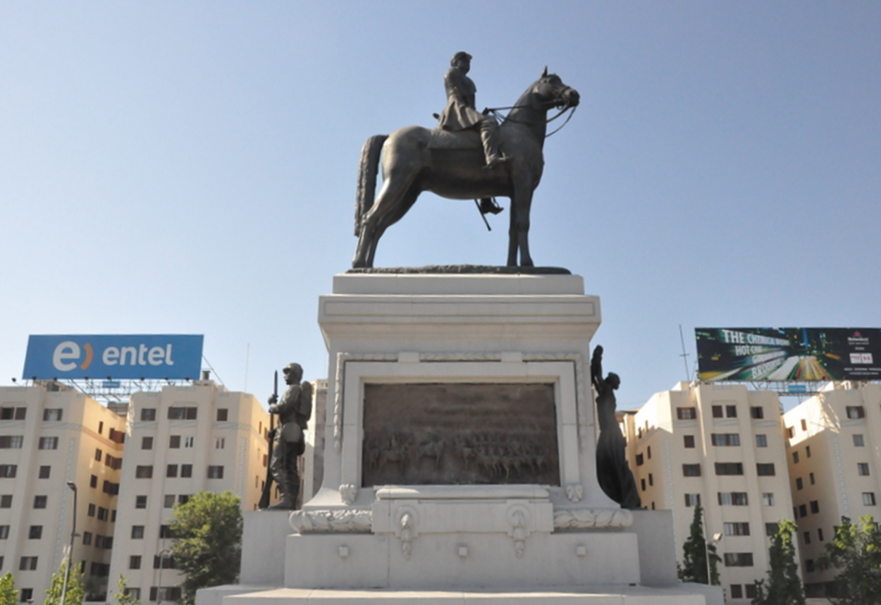

Slide 52
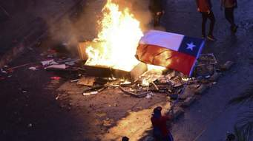

Slide 53
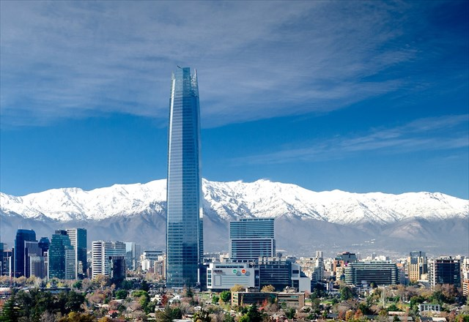
Sanhattan

Slide 54
Culture
Two
Literature Nobel Prizes

Slide 55
Gabriela Mistral 1945

Slide 56
King Gustaf V

Slide 57
Pablo Neruda 1971

Slide 58
King Gustaf Adolf VI

Slide 59
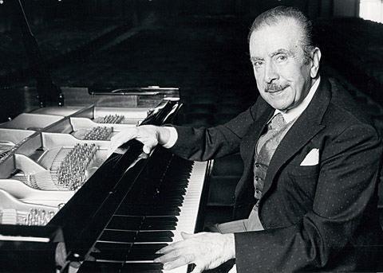
Claudio Arrau (1903-1991)

Slide 60
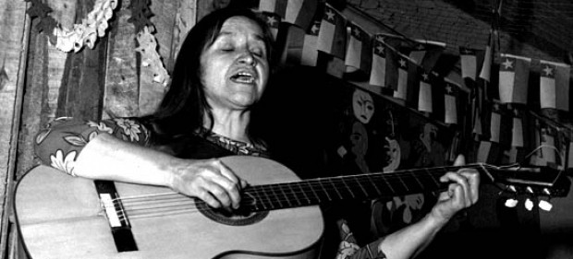
Violeta Parra (1917-1967)

Slide 61
Universities
USA 3,295
Best ranked: Harvard N° 1
Chile 79
Best ranked: Universidad de Chile N° 318

Slide 62
Copper

Slide 63
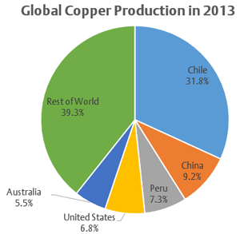
Copper

Slide 64
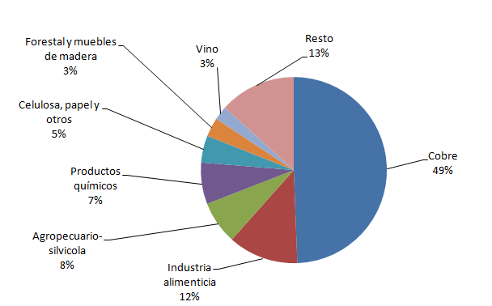
Chile: Exports by product 2017

Slide 65
Wine

Slide 66
Between Latitudes
32
38
193 wineries
in
13 valleys

Slide 67
2017 World Wine Production
281 million hectoliters
2,81e+10 liters

Slide 68
By country
1. Italy 18.75%
2. France 18.33%
3. Spain 16.67%

Slide 69
By country
4. USA 9,71%
5. Argentina 6,25%
6. Australia 5,83%

Slide 70
By country
7. Chile 5,42%
8. Sudáfrica 4,58%
9. Germany 3,75% 10. Portugal 2,92%

Slide 71
NATURAL HAZARDS
Severe earthquakes
123 Active Volcanoes
Tsunamis

Slide 72
LABOUR FORCE
8,360,900

Slide 73
LABOUR FORCE BY OCCUPATION
Agriculture: 13.2%
Industry: 23%
Services: 63.8%

Slide 74
Financial Market Assets
Insurance
Companies (57)
Banks (25)
US$ 239 Billion
Others* (19)
US$ 47 Billion
US$ 44 Billion
10%
10%
50%
30%
AFP (6)
US$ 144 Billion
(*) Private Mutual Funds, Social Mutuals, etc.
 | 100% Local | 100% Foreign | Both
AFP | 3 | 3
P&C Insurance Companies | 13 | 14
Life Insurance Companies | 19 | 11
Banks | 13 | 12 | 2
Others (*) | 13 | 5 | 2
Capital Originated
Notes:
Ignacio
Assets management by Chilean Financial Industry
The first local institutional investor are banks with US$187 Billion
Second are AFPs with US$113 Billion
And third they are Insurance Companies with US$35 Billion
In Chile works 25 banks, 6 AFP and 51 Insurance companies
In the Botton figure you have the Capital Originated
3 AFP are 100% Foreign Capital and 3 AFP are 100% local capital
in case of the banks 12 are 100% Foreign Capital ,11 are 100% local capital and 2 are boths
In Life nsurance Companies 18 are Foreign capital, 10 are 100% local capital and 3 are both

Slide 75
Health 7%
Private: 16% of population
13 “Isapres”
Public: 84% of population

Slide 76
PENSIONS 10%
Individual account savings
6 Private Pension Funds Administrators

Slide 77
2020
Unemployement 6.9% (N0v 2019)
2019 Inflation estimate 3%
Growth rate 2020 estimate 1%

Slide 78
Recommended readings
PRINTED SOURCES
Collier, Simon. A History of Chile. Cambridge University Press. 2nd. edition. 1984.
Mamalakis, Markos. The Growth and Structure of Chilean Economy: From Independence to Allende. Yale University Press. 1976
Muñoz, Heraldo & C.Portales. Elusive Freindship: A Survey of U.S.-Chilean Relations. Reiner, 1991.
Rector, John. The History of Chile. New York, Palgrave. 2005
Subercaseaux, Benjamin. Chile, a Geographic Extravaganza. 1943.
Dolencias Históricas de la memoria ciudadana. (Chile, 1810-2010)
Gabriel Salazar. 2016
INTERNET http://www.thisischile.cl
https://www.cia.gov/library/publications/the-world-factbook/geos/ci.html

Slide 79
Thank you,
Luis Gumucio
lgumucio@gmail.com

