Slide 1
The People of Chilean North Patagonia: the Soul, the Skill and the Drive

Slide 2
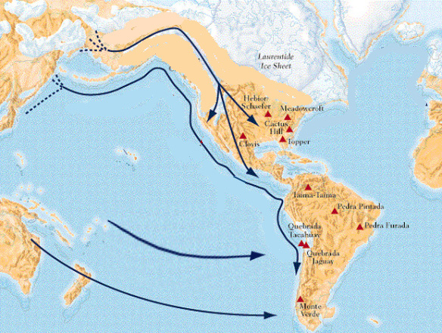

Slide 3
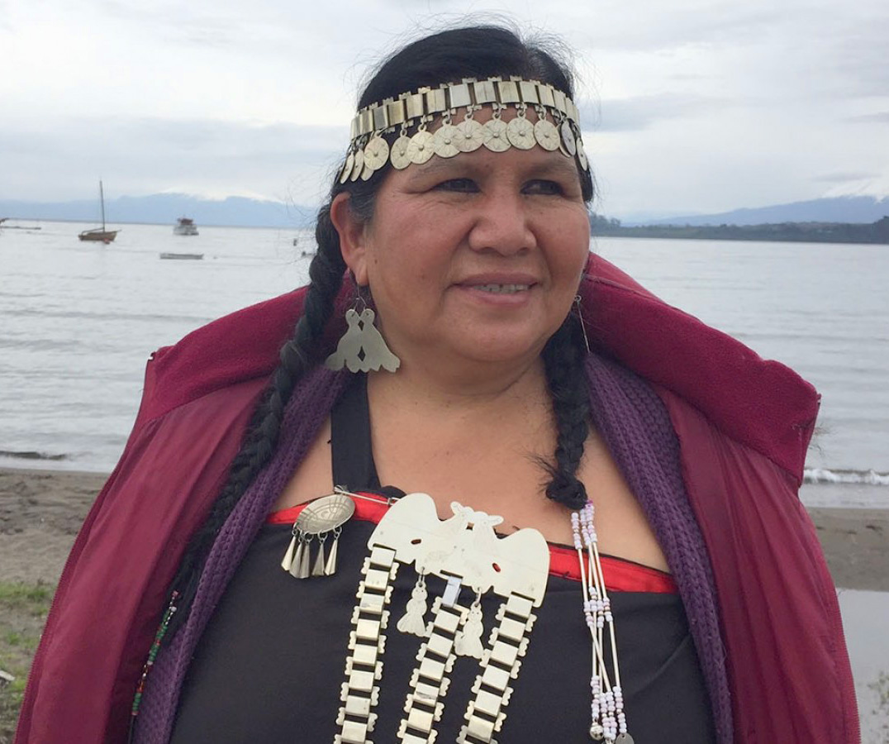
The Soul

Slide 4
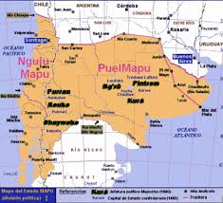

Slide 5
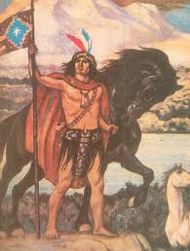
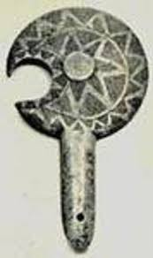
Lautaro (Leftrarü)
Toki

Slide 6
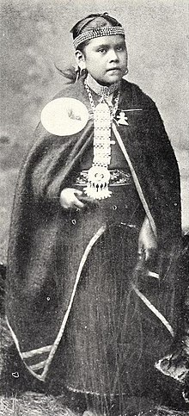
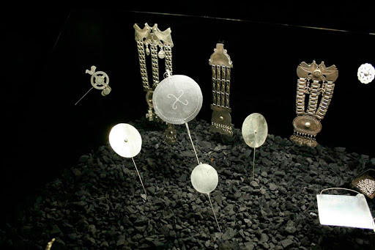

Slide 7
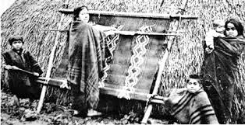
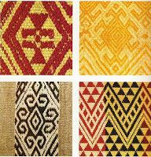

Slide 8
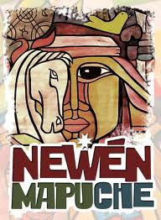
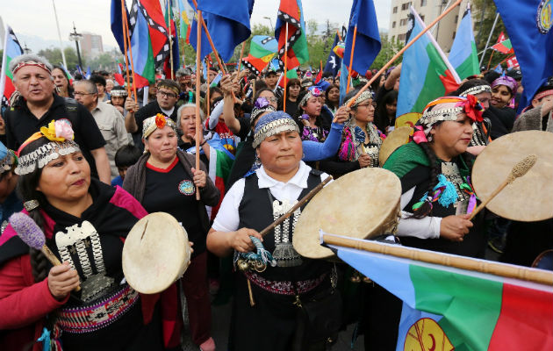
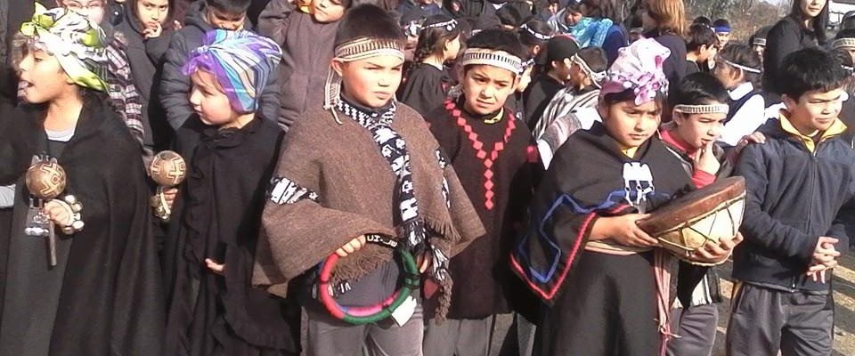

Slide 9
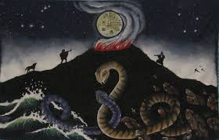
“Threng Threng Vilu” “versus Co Co Vilu”

Slide 10
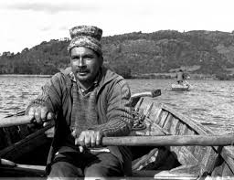
Chiloe: the Skill

Slide 11
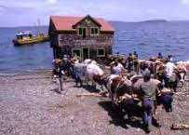
Minga

Slide 13
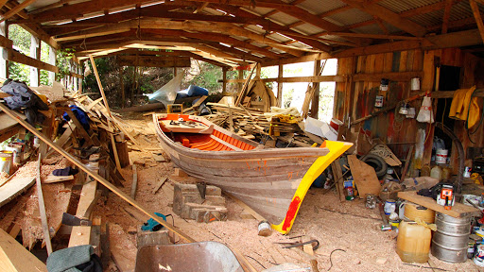
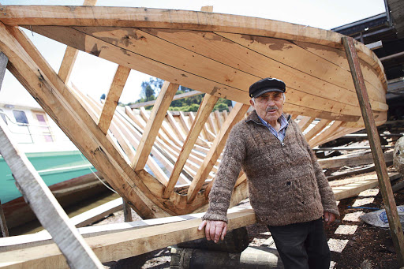

Slide 14
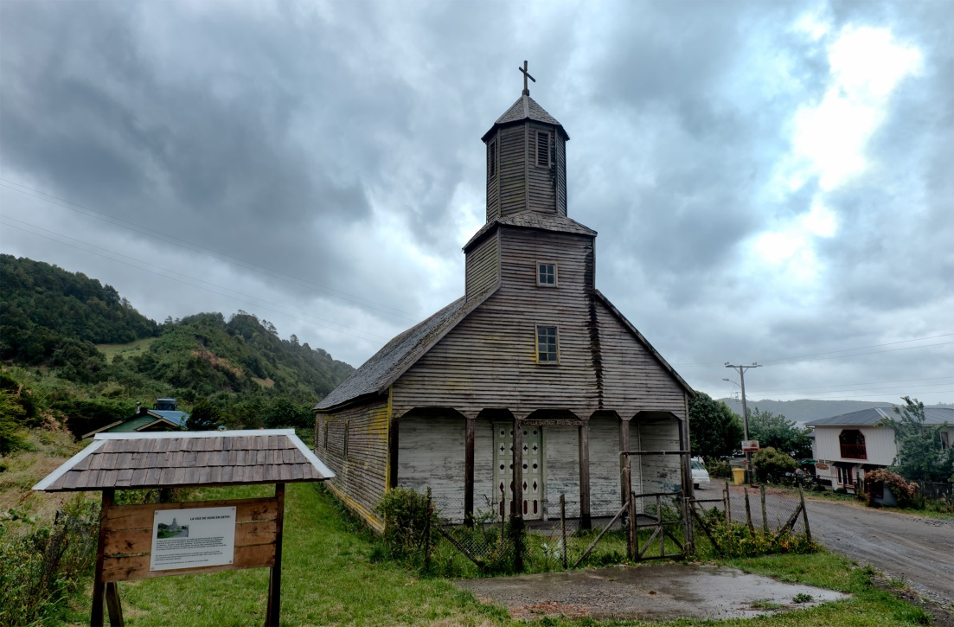
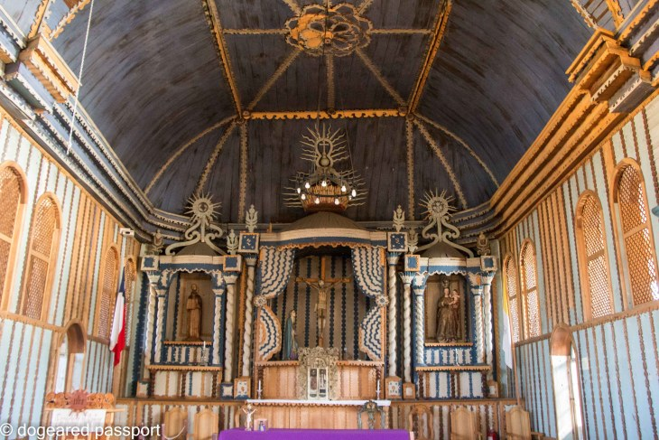
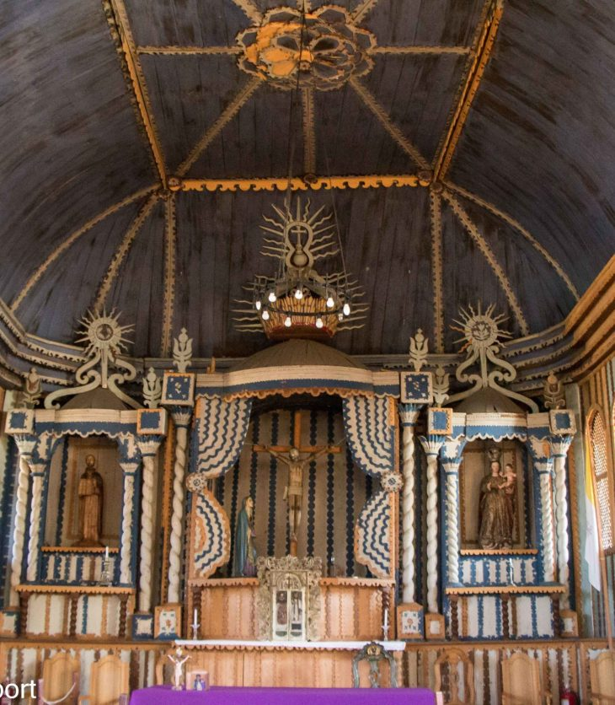
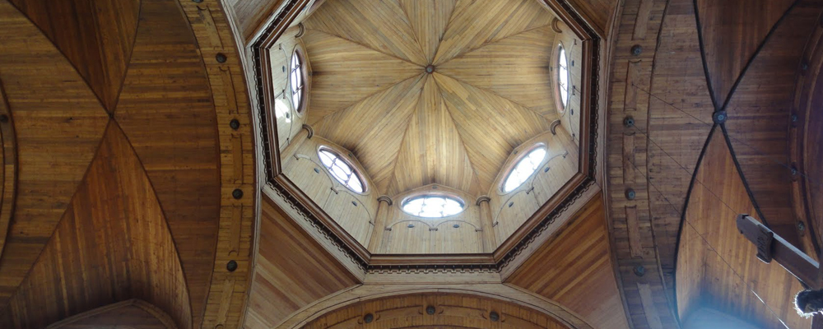

Slide 16
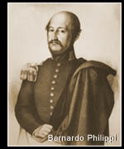

Slide 18
European immigrants: the Drive

Slide 19
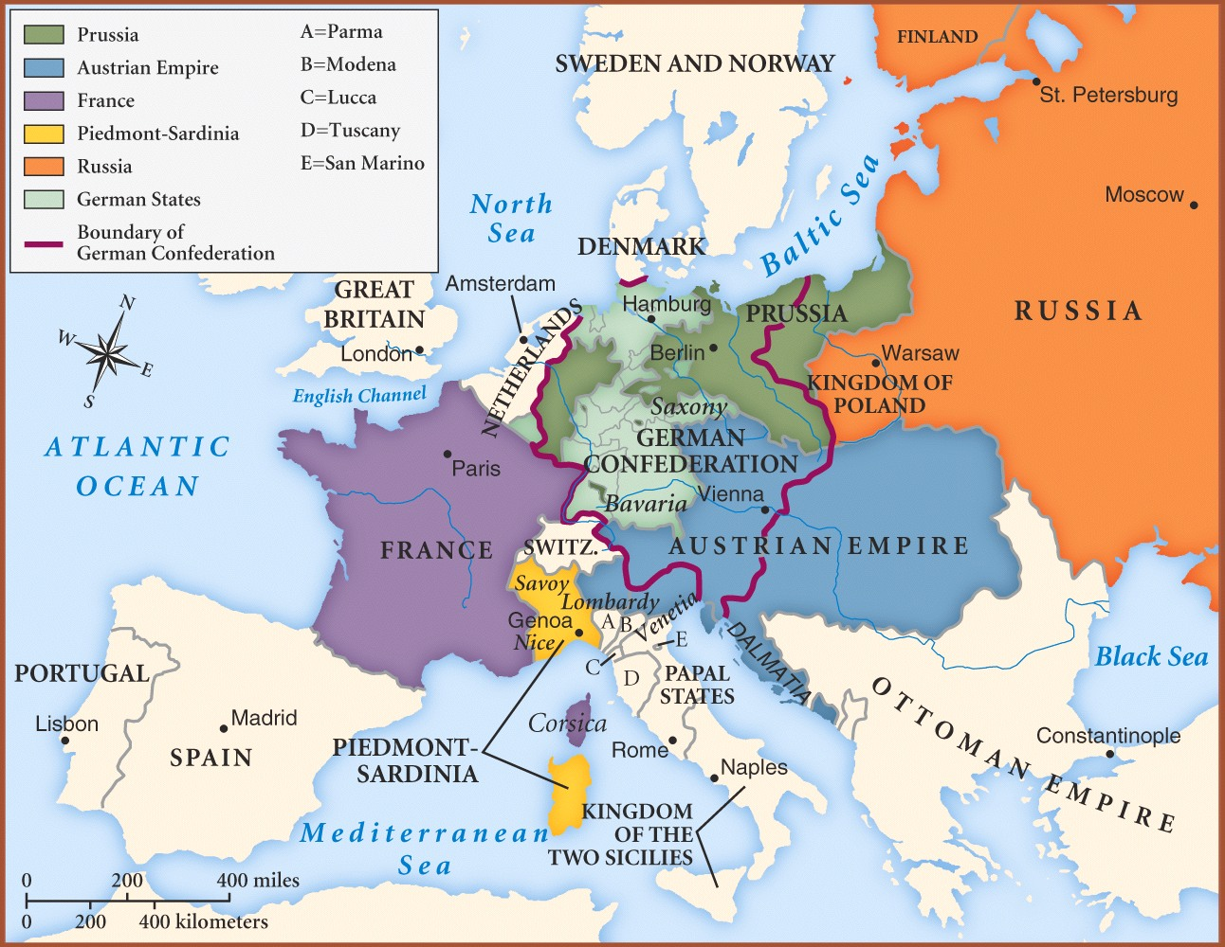
Europe 1850

Slide 20
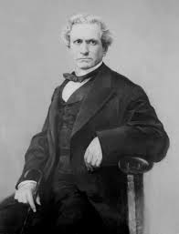
President Montt and Minister of the Interior Varas

Slide 21
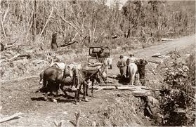
Road from Puerto Montt to Puerto Varas

Slide 22
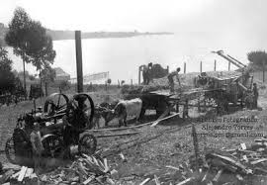

Slide 23
The promise…
We will be honest and hardworking Chileans like any other. We will defend our adoptive country joining the ranks of our new compatriots against all foreign oppression and with the determination and resolve of the man that defends his nation, his family, his interests. Never will the country that has adopted us as its children reasons to regret such illustrated, humane and generous gesture…”
Karl Andwanter, inmigrant, November 18th, 1850

Slide 24
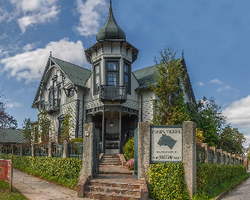
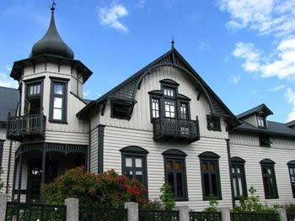
Southern Victorian Neoclassic

Slide 25
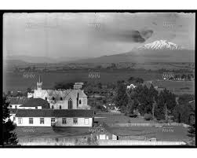
Puerto Varas 1905

Slide 26
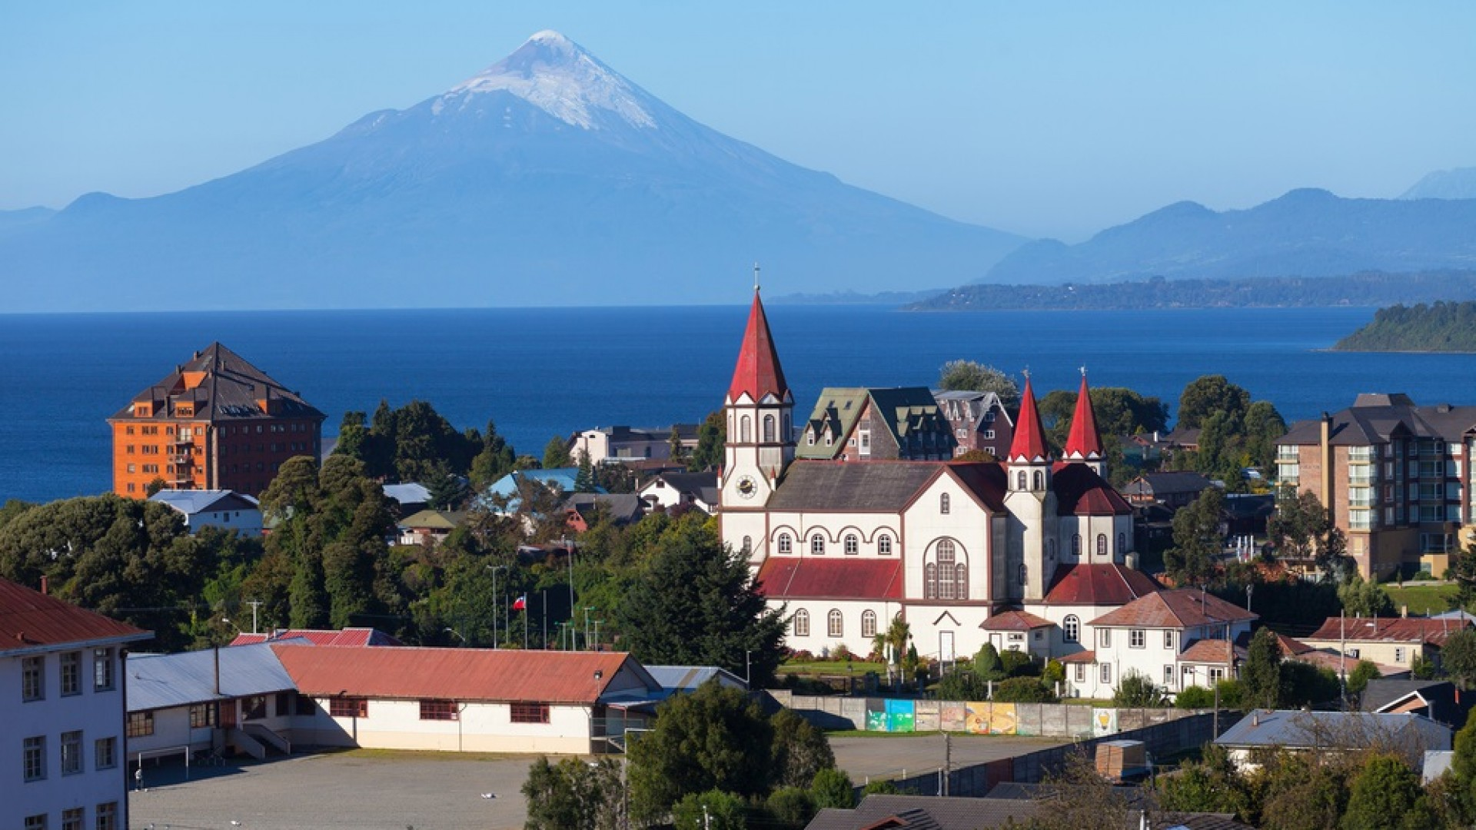
Thank You ALL

