Slide 1
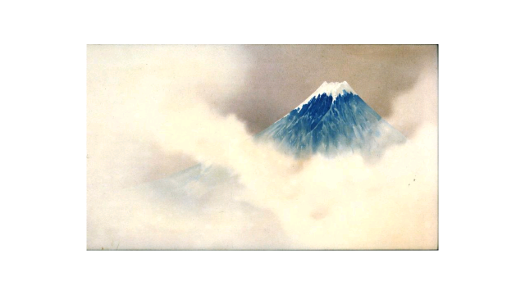
Japan: Arts and Culture
Margaret Barbee PhD
April 2019

Slide 2
Part 2: Dining and Gardens

Slide 3
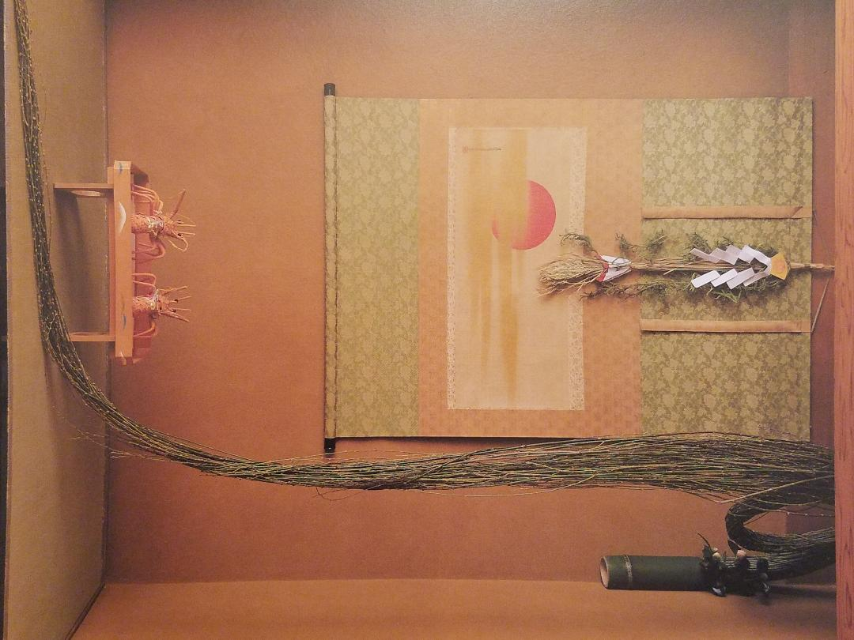
New Year’s Eve Table

Slide 4
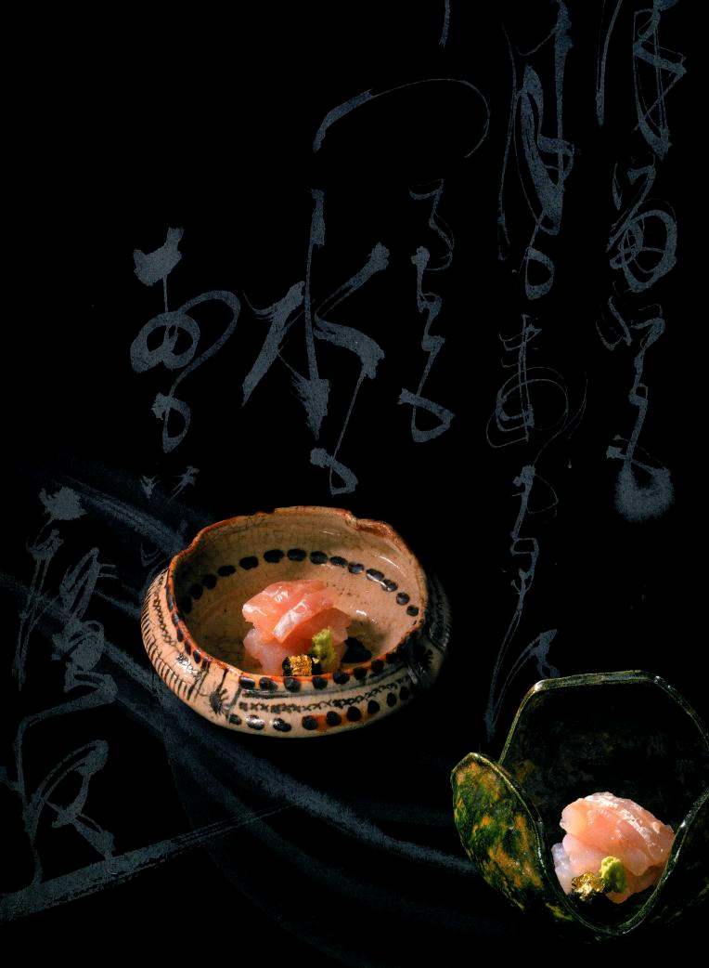
Sushi with Caligraphy

Slide 6
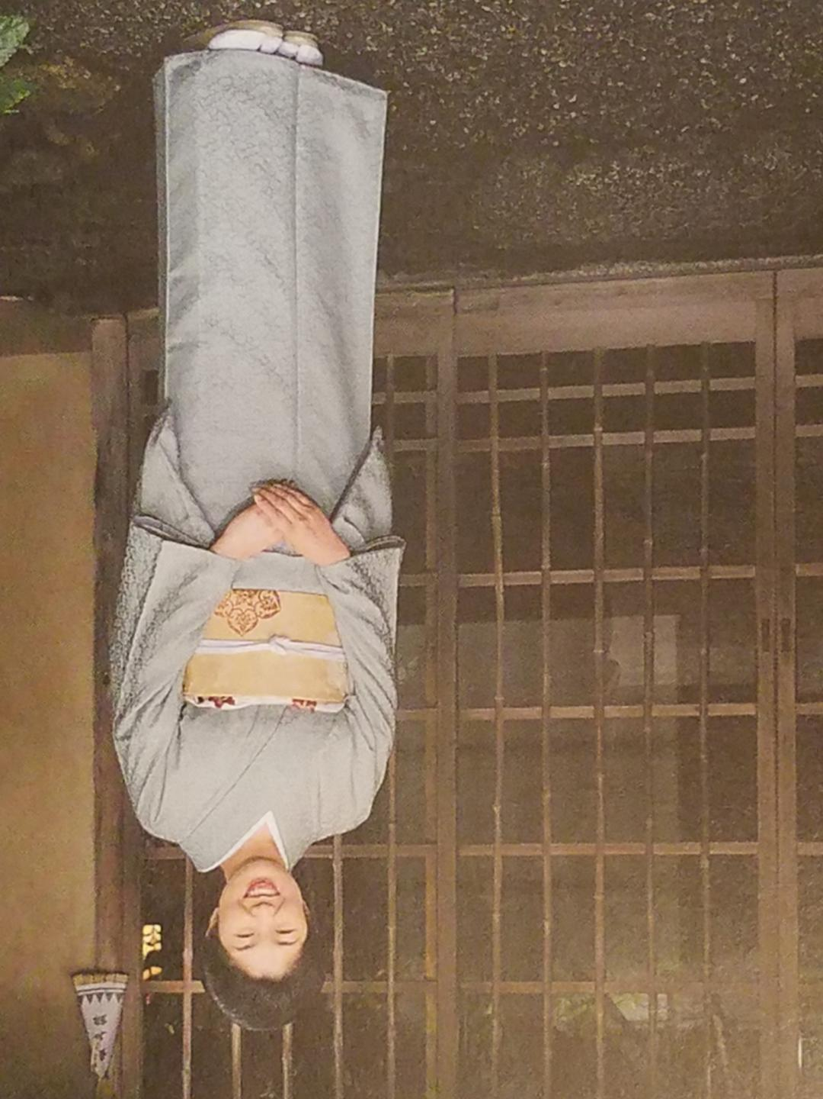

Slide 7
Presentation of colorful foods

Slide 8
Fresh whole crab on ice

Slide 10
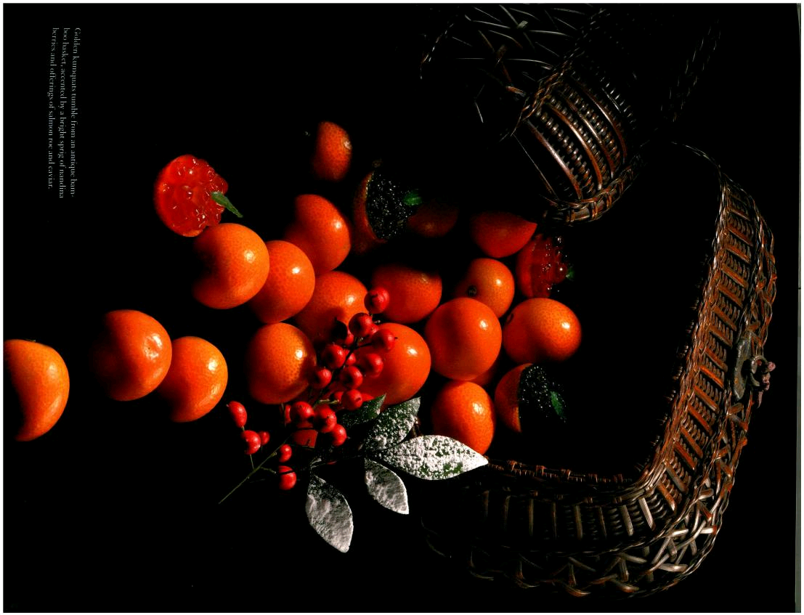

Slide 11
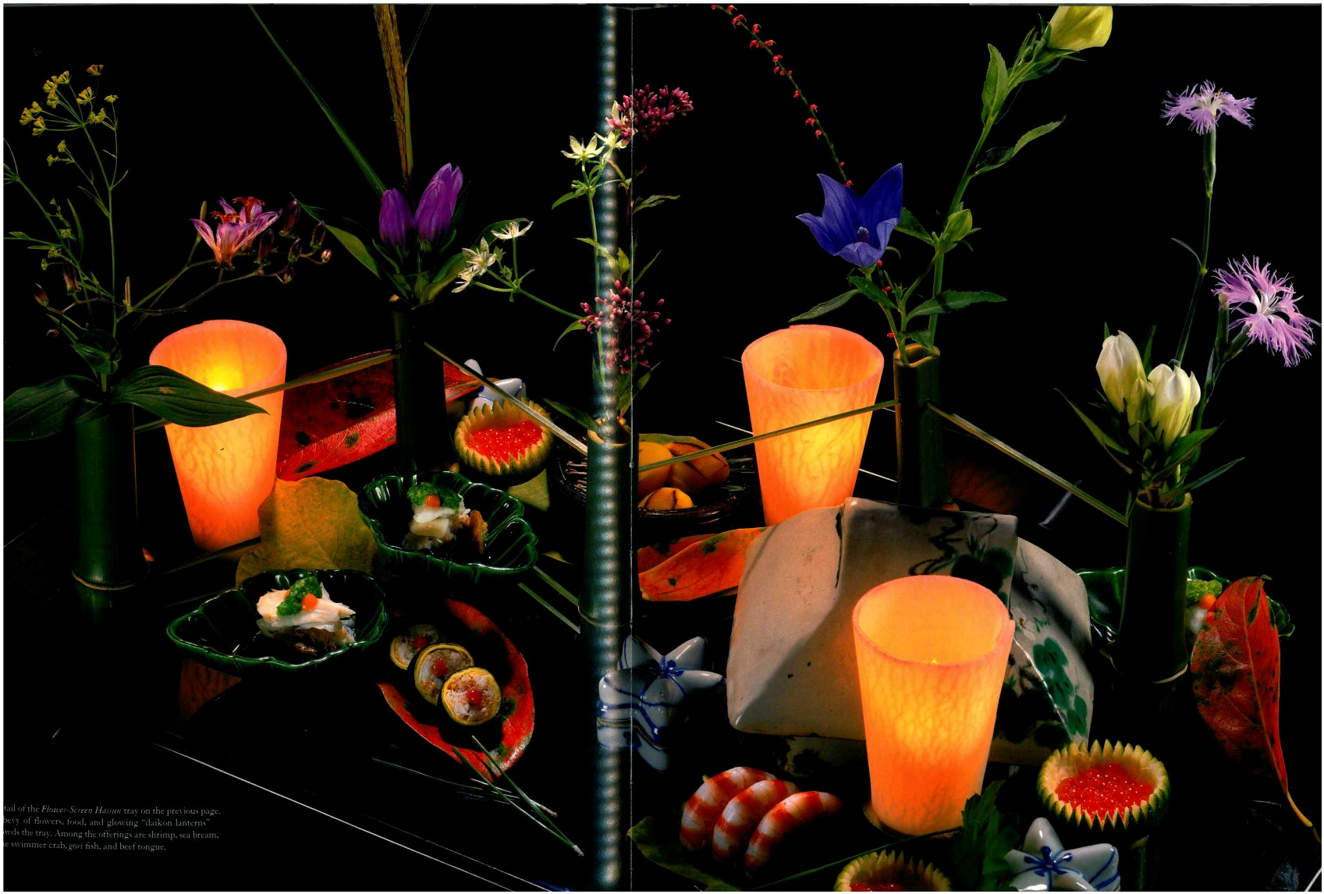

Slide 12
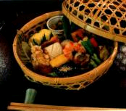

Slide 13
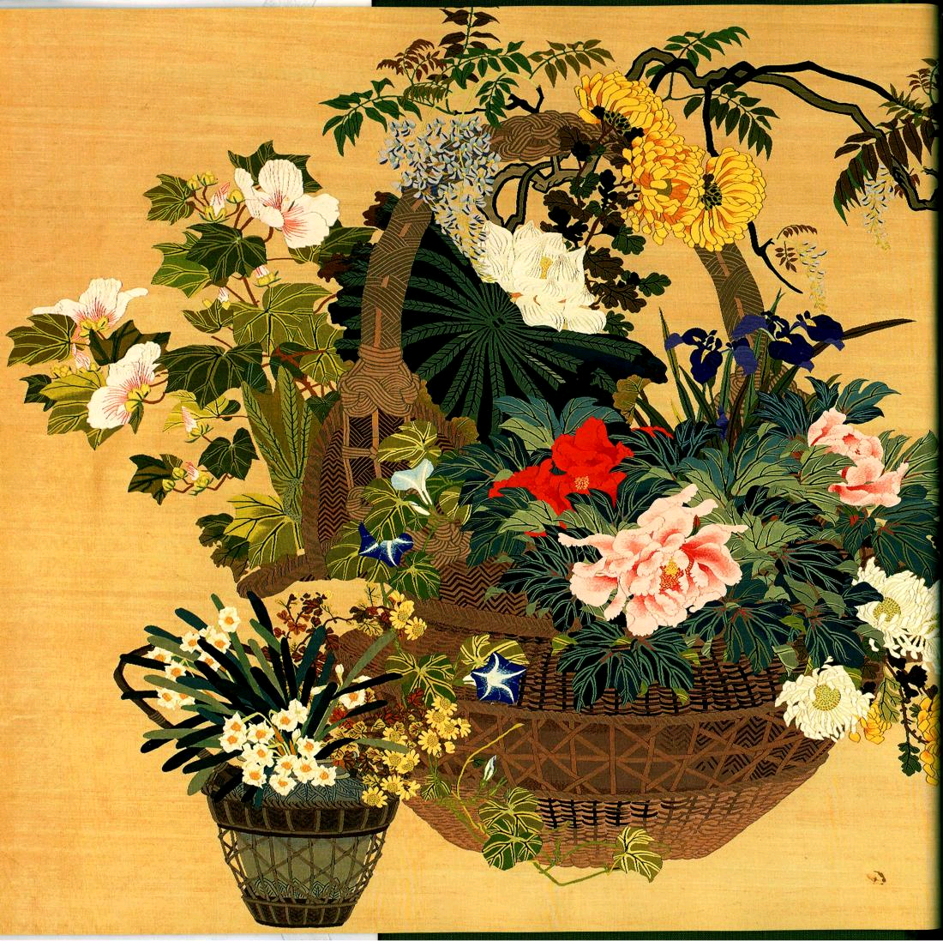

Slide 14
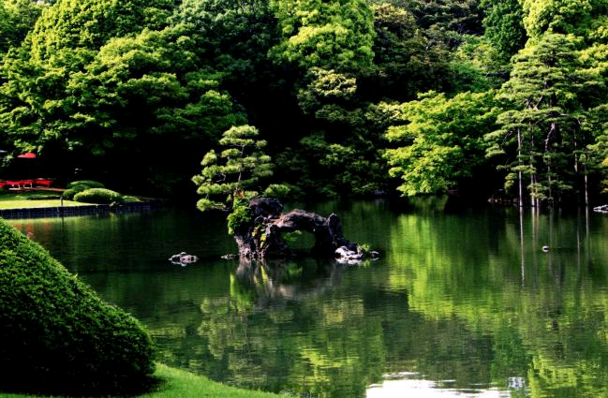

Slide 15
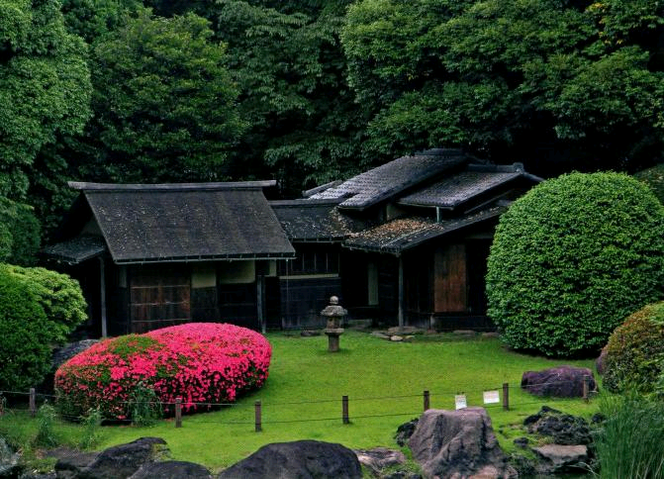

Slide 16
Garden with raked stones

Slide 17
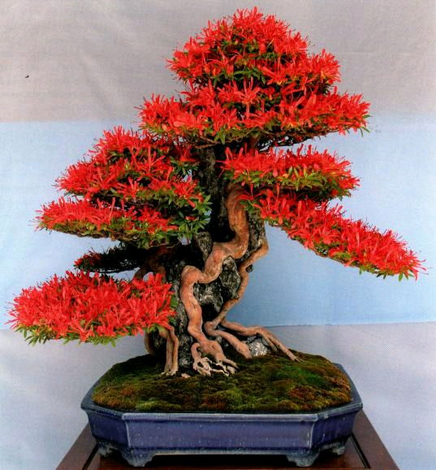

Slide 18
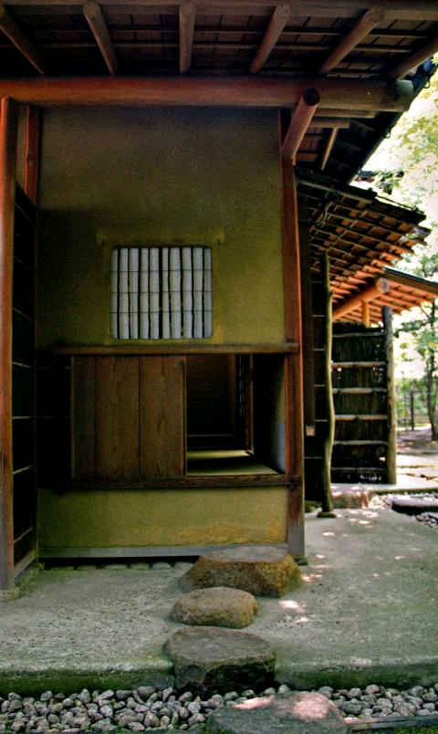

Slide 19
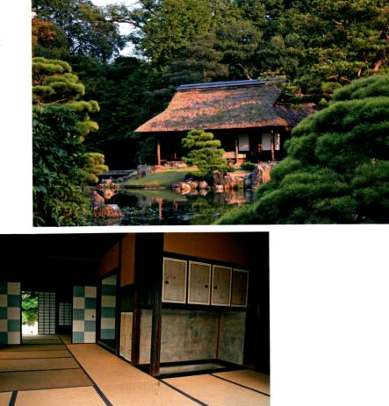

Slide 20
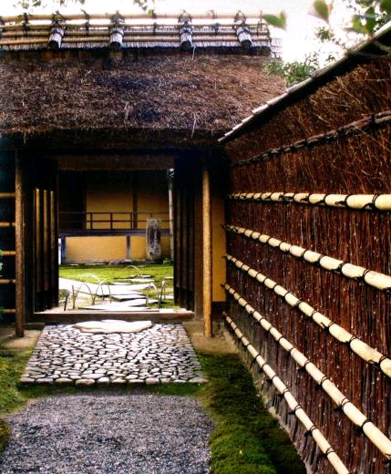

Slide 21
